Slide 1
Russian school system
Shvorina olesya
Vasyukov mikhail
Ville alexander
10 «А» CLASS

Slide 2
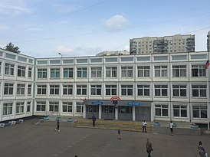
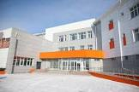
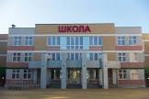
Complete school education in Russia lasts eleven(11) classes. Incomplete (basic) education lasts nine(9) classes. Russian schools provide students with a general education.
Schools that provide only a general education course are called «general education», and institutions that provide in-depth knowledge in individual disciplines are called «lyceum» or «gymnasium».
Education in public schools is officially free.

Slide 3
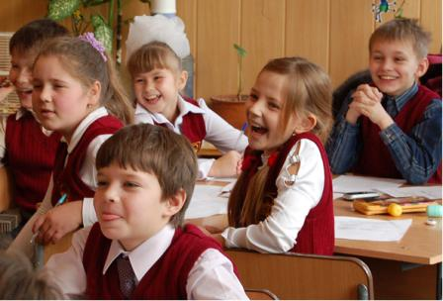

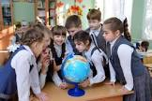



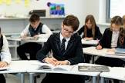
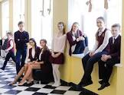
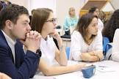

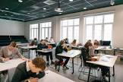

Timeframes for completing educational programs:
1) Primary general education - four (4) years (from first to fourth grade),
2) Basic general education - five (5) years (from fifth to ninth grade),
3) Complete general education - two (2) years (from tenth to eleventh grade).

Slide 4
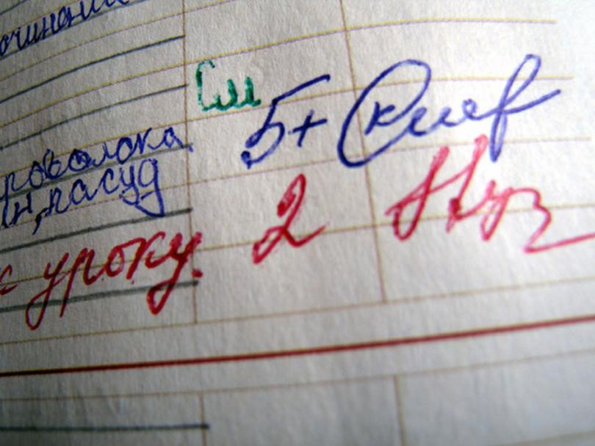
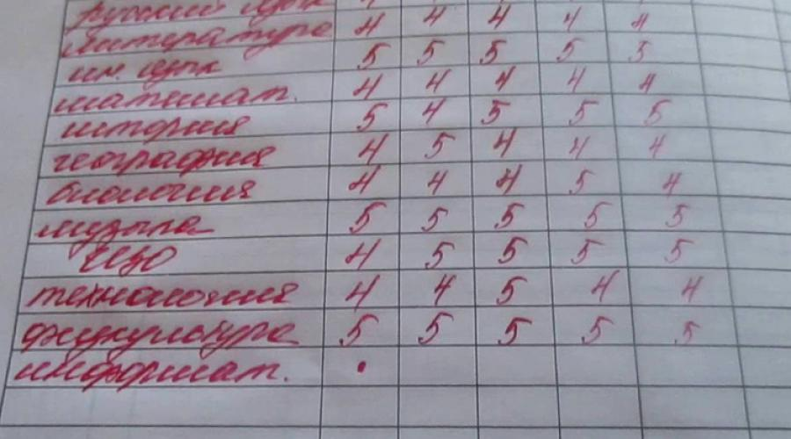
Еvaluation system:
«5 (excellent)» - used in case of deep assimilation of the material.
«4 (good)» - given when the material has been mastered, but there are minor errors in the task.
«3 (satisfactory)» - used when there is some knowledge, in which the student makes many mistakes.
«2 (unsatisfactory)» - indicates a very poor understanding of the material.

Slide 5




and at the end of eleven grades, the Unified State Exam.
and at the end of eleven grades, the Unified State Exam.
and at the end of eleven grades, the Unified State Exam.
Maximum number of lessons per day:
1)From first to fourth grade - 5 lessons per day.
2)From fifth to ninth grade - 7 lessons per day.
3)From tenth to eleventh grade - 8 lessons per day.
Lessons last forty-five (45) minutes.
The smallest change lasts 5 minutes, and the largest twenty (20) minutes.

Slide 6




At the end of nine grades, students take the Main State Exam,
and at the end of eleven grades, the Unified State Exam.
Each student who successfully completes the last stage of training receives a certificate, which indicates all the final grades in the subjects studied.

Slide 7
Our idea of an ideal school:

Slide 8
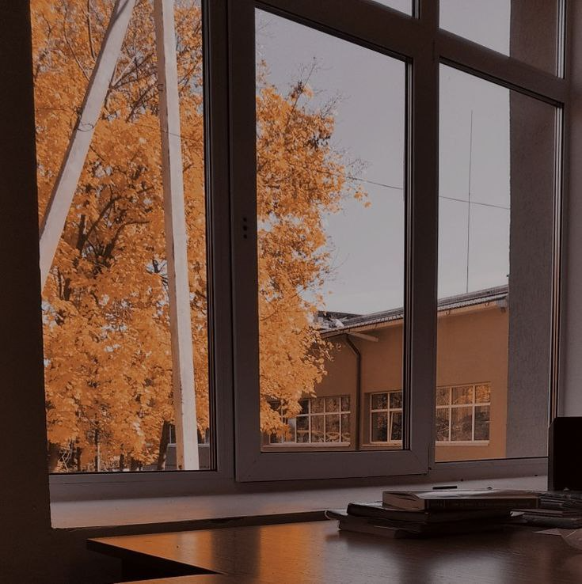
We would really like our school to have a little less workload and more active classes!

Slide 9
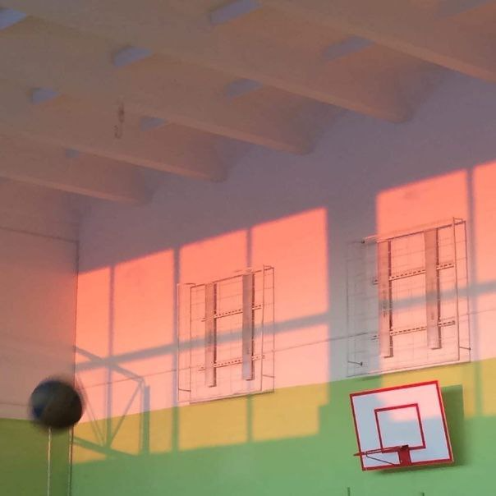
it would be very cool to add additional classes in different areas to the schedule, for example, such as: vocals, choreography, playing musical instruments and so on.

Slide 10
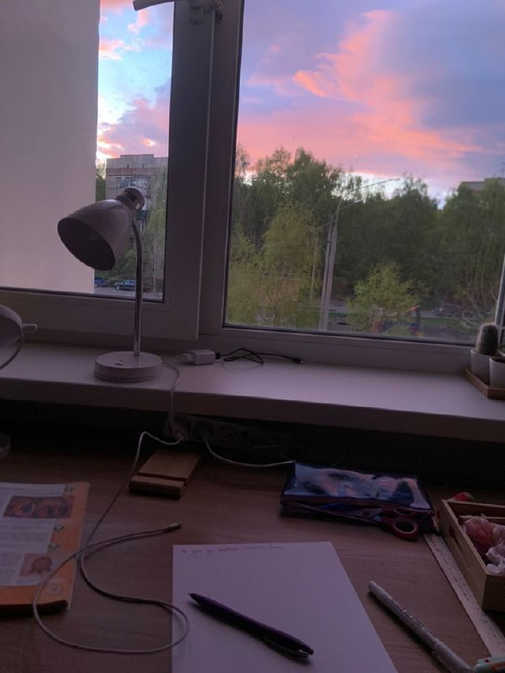
I think that if all the lessons in our school were held in the format of games, we would learn the material better. no wonder they say that playing, we learn!

Slide 11
That's all. Thanks for your attention!

